Slide 1
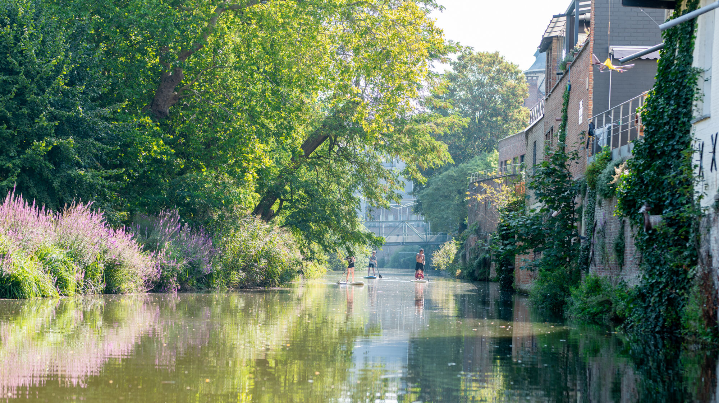
WaterGuard
Notes:
What if we could see exactly what’s beneath our rivers - making them safer and cleaner without disturbing nature?
Every year tons of waste gets dumped into our river system, with that little piece of information, would you swim or fish in it today?
What if you had real time data to make sure? Rivers sustain nature and industry, but without accurate data, Mechelen and its river remain disconnected.
Karolis
Aryan
Yevhen
Ryno

Slide 2
Problem
Waste and Environmental Degradation
Lack of Accessibility
Limited Community Awareness
Notes:
The Inner Dijle should be a space where people, plants, and animals coexist in harmony, but right now, it faces challenges in accessibility, sustainability, and community engagement.
Here are some key problems that we decided to focus in,
-Waste and environmental degradation:- it clearly needs an improvement and more sustainable practices.
-Lack of accessibility: for example, its often hard to get to the river, most places are covered in brush.
-Limited community awareness: Many people don’t know about different spicies that exist in a water.

Slide 3
Problem
Water quality of Mechelen Inner Dijle Insufficient: "We also want to monitor other waterways"
Source: HNL
Notes:
The Inner Dijle should be a space where people, plants, and animals coexist in harmony, but right now, it faces challenges in accessibility, sustainability, and community engagement.
Here are some key problems that we decided to focus in,
-Waste and environmental degradation:- it clearly needs an improvement and more sustainable practices.
-Lack of accessibility: for example its often hard to get to the river, most places are covered in brush.
-Limited community awareness: Many people don’t know about different spicies that exist in a water.

Slide 4
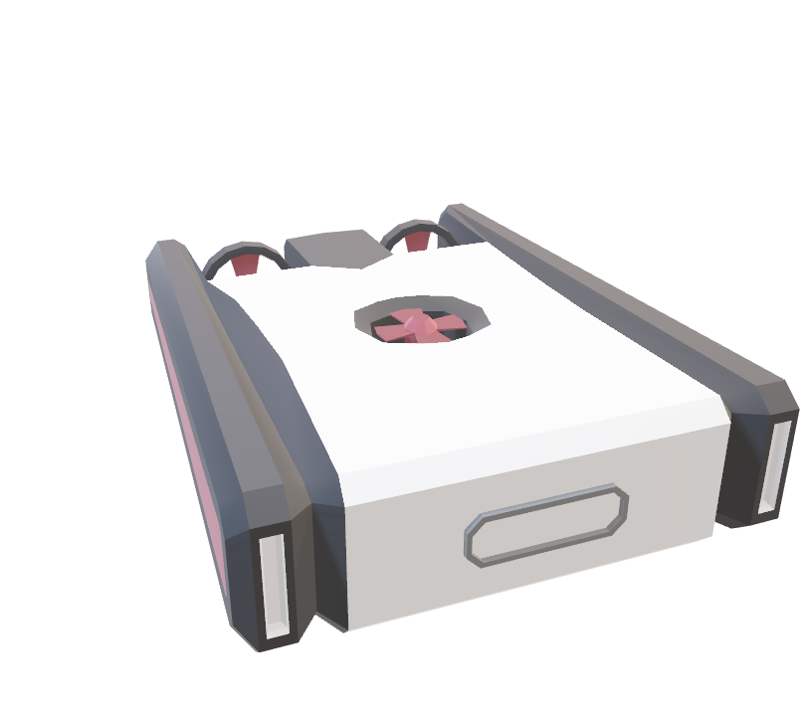
Solution
Underwater drone
Solar recharging
Dashboard
Gamification
USP
Notes:
That’s where Water Guard comes, but first let me tell you a story A month ago the trash container was stolen from a student house and it took the whole week for the police to figure out that some students send it to the river, but with our water guard it could’ve been found within hours, but it’s not only underwater police, drones itself take a lot of measures into account, not only scanning objects, fish hourly in area, but they take temperature, water samples to measure pH level, bacterias and other measures to determine swimming safety and other important metrics.
If suspect object is detected by the censors that are powered by AI, Mechelen city or police is getting a notification about it.
The water guard drones would be placed each 200 meters to have the whole overview of the river in Mechelen. Now you might be thinking how it will be powered?
We have Solar power docking stations which recharges the drone automatically.
Who here is confused about this solution? Don’t worry, that’s where our app for citizens of Mechelen comes with user friendly experience, it allows users to see an overview, like water quality(one of the important measures) on a dashboard about the river current state. To address one of the problems you can see water Level too, this is very important for mood flooding, if water level is high, government gets notified to check it to avoid any costs.
If user wants to know information about more specific place, for example, near the park, citizens can select the zone in our interactive map where it will give information about that zone situation at current time.
Everyone can look at the beautiful river from above, but with us you can see river life underwater

Slide 5
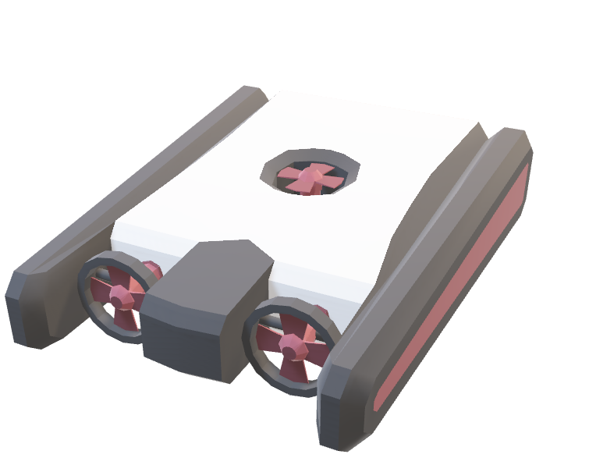
Solution
Underwater drone
Solar recharging
Dashboard
Gamification
USP
Notes:
That’s where Water Guard comes, but first let me tell you a story A month ago the trash container was stolen from a student house and it took the whole week for the police to figure out that some students send it to the river, but with our water guard it could’ve been found within hours, but it’s not only underwater police, drones itself take a lot of measures into account, not only scanning objects, fish hourly in area, but they take temperature, water samples to measure pH level, bacterias and other measures to determine swimming safety and other important metrics.
If suspect object is detected by the censors that are powered by AI, Mechelen city or police is getting a notification about it.
The water guard drones would be placed each 200 meters to have the whole overview of the river in Mechelen. Now you might be thinking how it will be powered?
We have Solar power docking stations which recharges the drone automatically.
Who here is confused about this solution? Don’t worry, that’s where our app for citizens of Mechelen comes with user friendly experience, it allows users to see an overview, like water quality(one of the important measures) on a dashboard about the river current state. To address one of the problems you can see water Level too, this is very important for mu d flooding, if water level is high, government gets notified to check it to avoid any costs.
If user wants to know information about more specific place, for example, near the park, citizens can select the zone in our interactive map where it will give information about that zone situation at current time.
Everyone can look at the beautiful river from above, but with us you can see river life underwater

Slide 6
Support Innovation for Sustainability
In Mechelen, for Mechelaars

